Slide 1
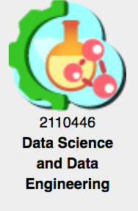
Data Preparation with Python 2110446: Data Science and Data Engineering
Peerapon Vateekul, Ph.D.
Department of Computer Engineering,
Faculty of Engineering, Chulalongkorn University
Peerapon.v@chula.ac.th

Slide 2

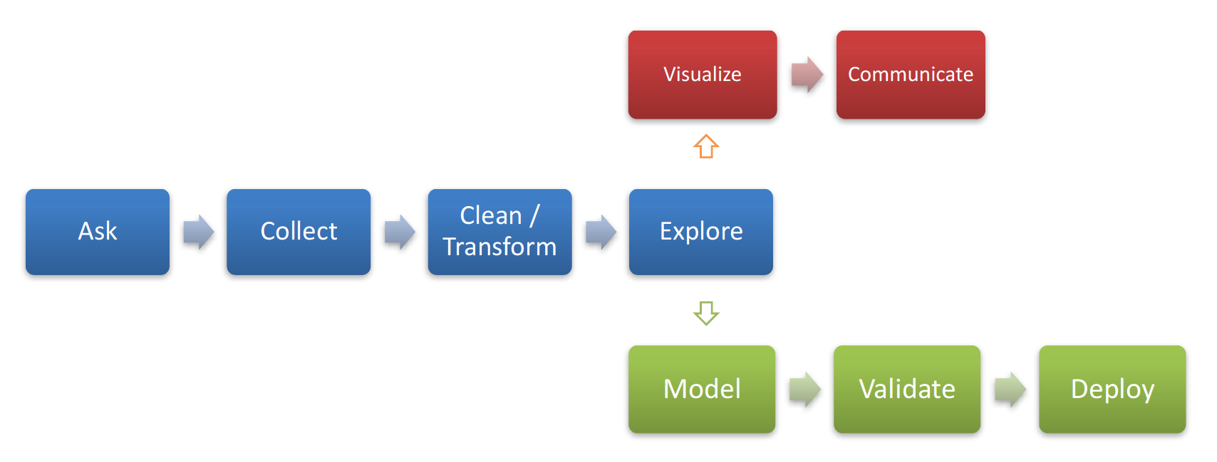
Previous class
Be able to explore data
Be able to identify issues in data
But do NOT process data yet
Cleansing & pre-processing
Data Science Process

Slide 3
Terminology: Data table
inputs
target
Age | Income | Gender | Province | Purchase
25 | 25,000 | Female | Bangkok | Yes
35 | 50,000 | Female | Nontaburi | Yes
32 | 35,000 | Male | Bangkok | No
Row
Example, instance, case, observation, subject
Column
Feature, variable, attribute
Input
Predictor, independent, explanatory variable
Target
Output, outcome, response, dependent variable

Slide 4
Terminology: Kinds of data
Data
Categorical
(qualitative)
Nominal
Ordinal
Numerical
(quantitative)
Categories cannot be compared
Categories with an implied order

Slide 5
Data preparation is very important!

Slide 6
Analytics workflow

Slide 7
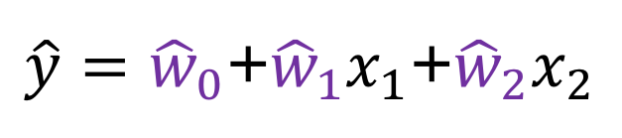
Data preparation challenges
Massive data sets
Temporal infidelity
Transaction and event data
Non-numeric data
Exceptional, extreme, and missing values
Stationarity
$\hat{y}={\hat{w}}_{0}$+${\hat{w}}_{1}x_{1}$+${\hat{w}}_{2}x_{2}$

Slide 9
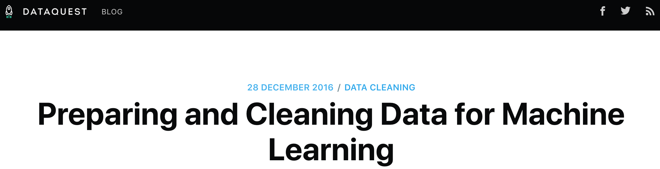
1) Examining the Data Set
2) Narrowing down columns manually
Remove Id’s
Irrelevant variables
Remove zipcode & date
Temporal infidelity (data from future)
Calculated variables
Decide target
Select studied cases
Distribution of target variables
Remove flat values
3) Preparing features for ML
Preview data
Handling missing values
Drop unqualified features
Investigate categorical features
Drop too many unique values (treat as Id)
Convert ordinal to numeric
Convert categorical to numeric
Check all numeric variables
https://www.dataquest.io/blog/machine-learning-preparing-data/

Slide 10
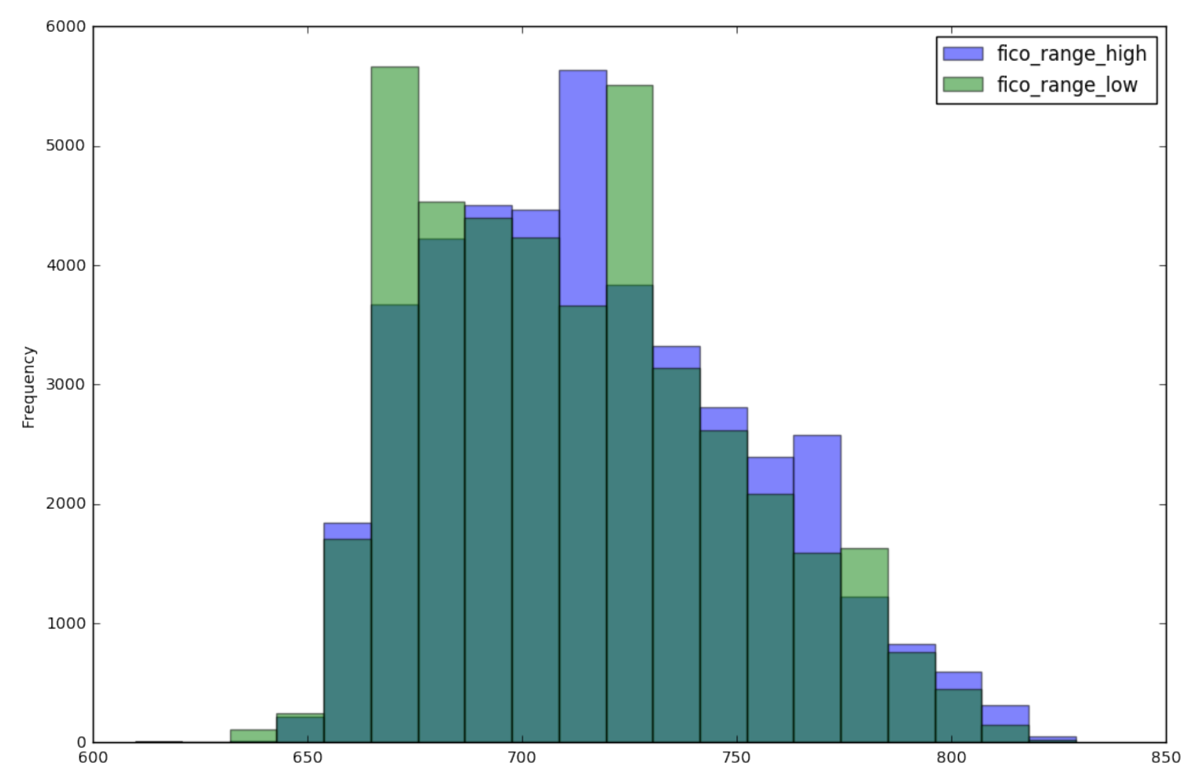
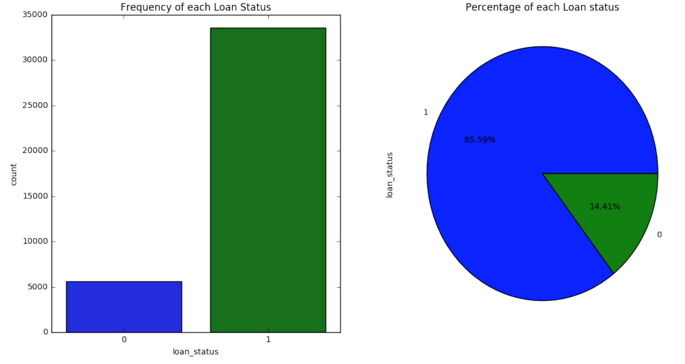
1) Examining the Data Set
Numerical variables
Out of ranges
Distribution: histogram
Categorical variables
Miscodes
Distribution: frequency table, bar chart
Target variable
Understand proportion of each class: bar chart, pie chart

Slide 11
2) Narrowing down columns: Feature understanding is extremely important!
Remove irrelevant features manually
Inputs
Target
Domain expert

Slide 12
2) Narrowing down columns (cont.): Remove unqualified features
Id’s (lack of generalization; overfit)
Variables with missing values > 50%
Categorical variables
Too many unique values (treat as Id’s)
Flat values (underfit)
Recode, consolidation (grouping)
Special ways to treat these data
Zip code
Distance to closet branch
Date/time
Recency

Slide 13
2) Narrowing down columns (cont.): Temporal Infidelity
Occurs when the input variables contain information that will be unavailable at the time that the prediction model is deployed.
Assume that the model will be deployed in July-2017
Should we include a variable called “FICO2017”, which is calculated at the end of the year?

Slide 14
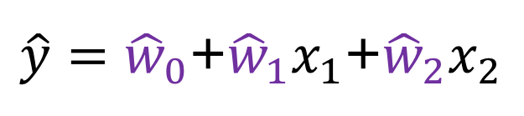
3) Preparing features for ML (cont.): Impute missing values
Numerical variables:
Mean
Median
Categorical variables:
Mode
? != 0
$\hat{y}={\hat{w}}_{0}$+${\hat{w}}_{1}x_{1}$+${\hat{w}}_{2}x_{2}$

Slide 15
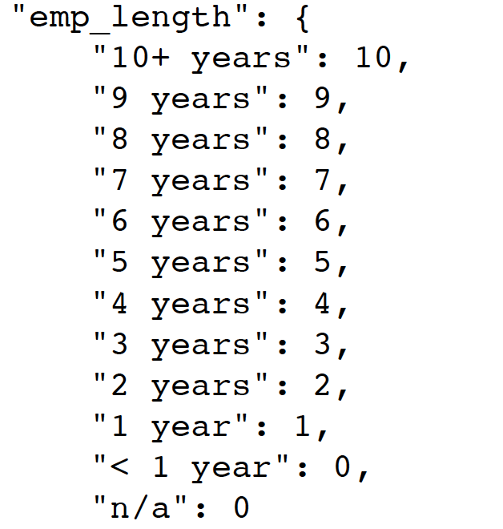
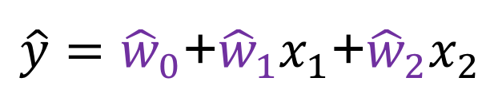
3) Preparing features for ML (cont.): Categorical to numeric variables
$\hat{y}={\hat{w}}_{0}$+${\hat{w}}_{1}x_{1}$+${\hat{w}}_{2}x_{2}$
Ordinal variable
Enumerate
Nominal variable
One-hot vector (dummy codes)
Smoothed weight of evidence (SWoE)

Slide 16
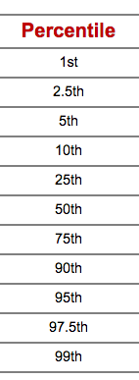
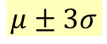
3) Preparing features for ML (cont.): Truncate outliers
$$μ±3σ$$
Outlier, leverage points, extreme values

Slide 17
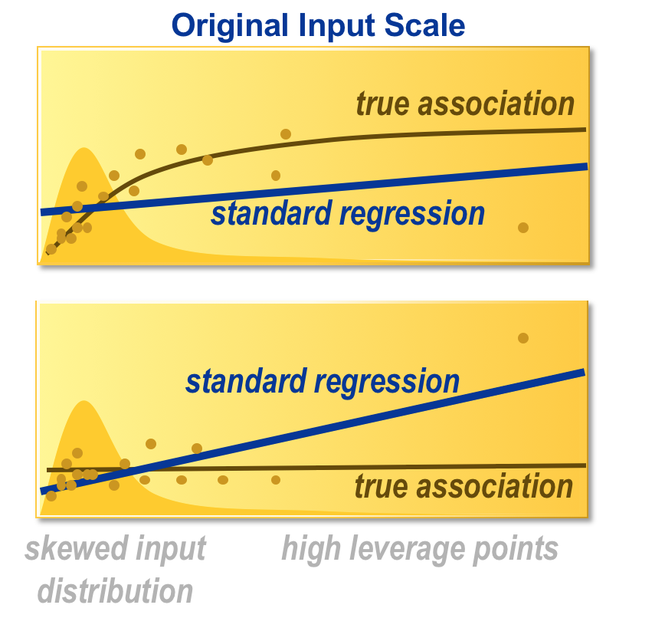
3) Preparing features for ML (cont.): Feature transformation
$\hat{y}={\hat{w}}_{0}$+${\hat{w}}_{1}x_{1}$+${\hat{w}}_{2}x_{2}$
Skewness
Example: Salary, Balance in bank account
Solutions: Log, Binning

Slide 18
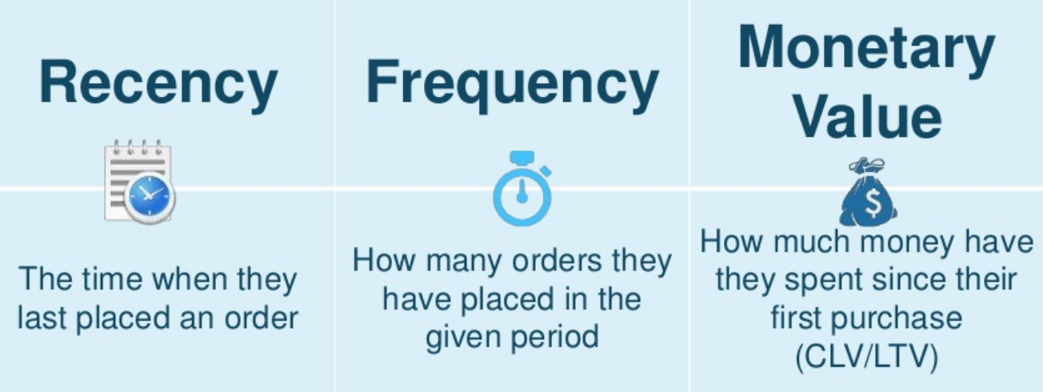
3) Preparing features for ML (cont.): Feature engineering
Feature engineering
Calculated variables
Behavior from transactional data (RFM/RFA)

Slide 19

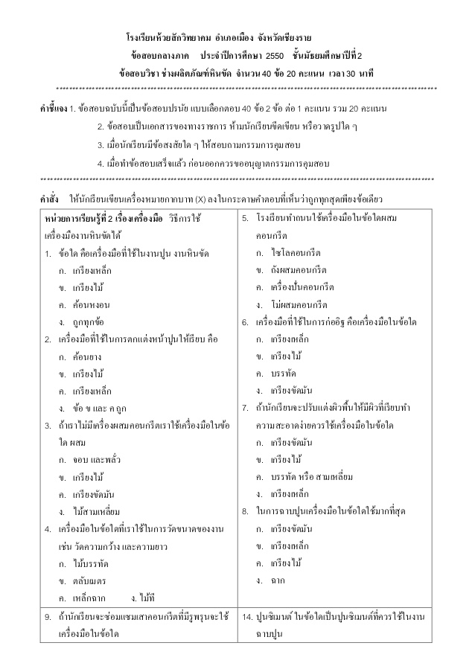
4) Other preprocessing steps: Train/Test/Validate
Training Data
inputs
target
Age | Income | Gender | Province | Purchase
25 | 25,000 | Female | Bangkok | Yes
35 | 50,000 | Female | Nontaburi | Yes
32 | 35,000 | Male | Bangkok | No
Validation Data
Age | Income | Gender | Province | Purchase
25 | 25,000 | Female | Bangkok | Yes
35 | 50,000 | Female | Nontaburi | Yes
Testing Data
Age | Income | Gender | Province | Purchase
25 | 25,000 | Female | Bangkok | ?

Slide 20
4) Other preprocessing steps: Train/Test/Validate (cont.)
Simple random sample
Stratification

Slide 21
Other data preparation processes
Impute missing values
Outlier detections
Feature transformation
Skewness
Split train/test
Simple random sampling
Stratification
Feature clustering
Feature selection

